Slide 1


HPC and AI convergence
An example from High Energy Physics
Sofia Vallecorsa
Frankfurt- 19/06/2019

Slide 2
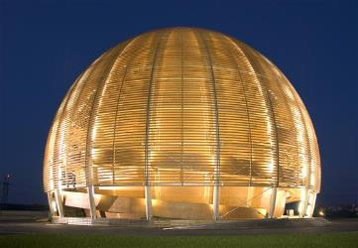
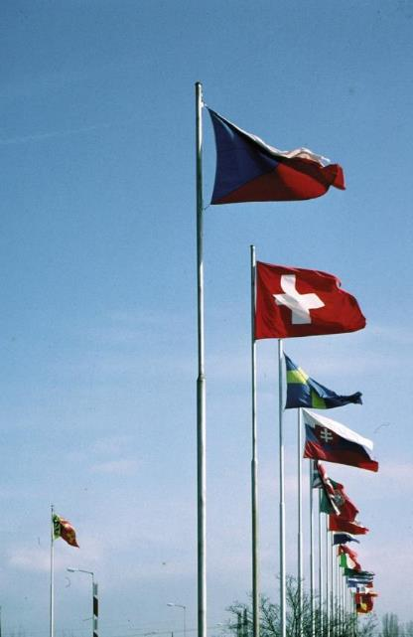
CERN
“Science for peace”
International organisation close to Geneva, straddling Swiss-French border, founded 1954
Facilities for fundamental research in particle physics
23 member states, 1.1 B CHF budget
3’197 staff, fellows, apprentices, …
13’128 associates
1954: 12 Member States
Members: Austria, Belgium, Bulgaria, Czech republic, Denmark, Finland, France, Germany, Greece, Hungary, Israel, Italy, Netherlands, Norway, Poland, Portugal, Slovak Republic, Spain, Serbia, Sweden, Switzerland, United Kingdom Candidate for membership: Cyprus, Slovenia
Associate members: India, Lithuania, Pakistan, Turkey, Ukraine
Observers: EC, Japan, JINR, Russia, UNESCO, United States of America
Numerous non-member states with collaboration agreements
2’531 staff members, 645 fellows, 21 apprentices
7’000 member states, 1’800 USA, 900 Russia, 270 Japan, …

Slide 3
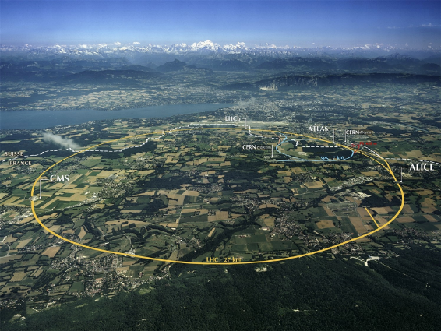
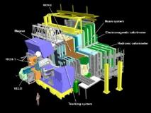
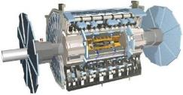
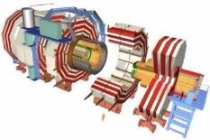
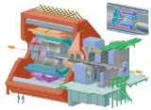
The Large Hadron Collider (LHC)

Slide 4
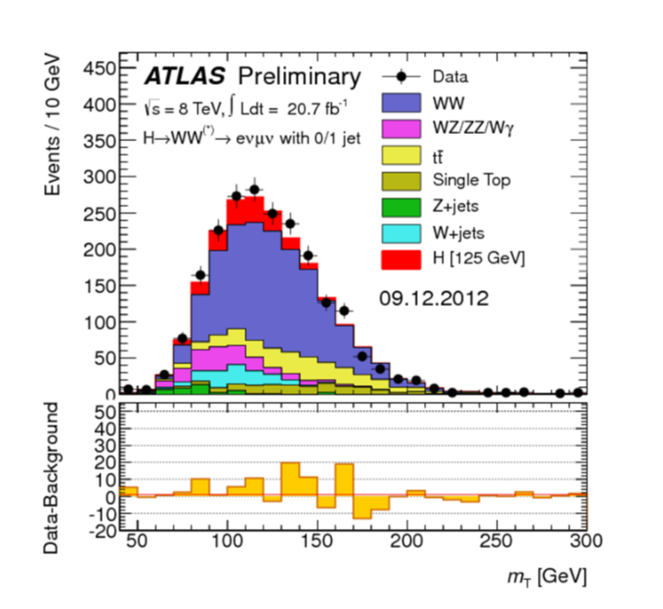
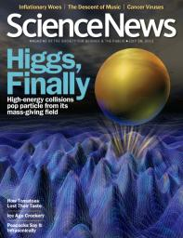
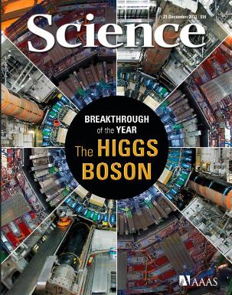
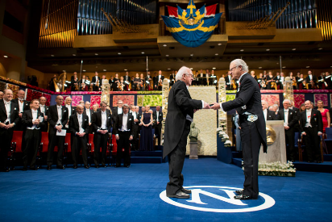
The Higgs Boson

Slide 5

The Higgs Boson completes the Standard Model,
but the Model explains only about 5% of our Universe
What is the other 95% of the Universe made of?
How does gravity really works?
Why there is no antimatter in nature?

Slide 6
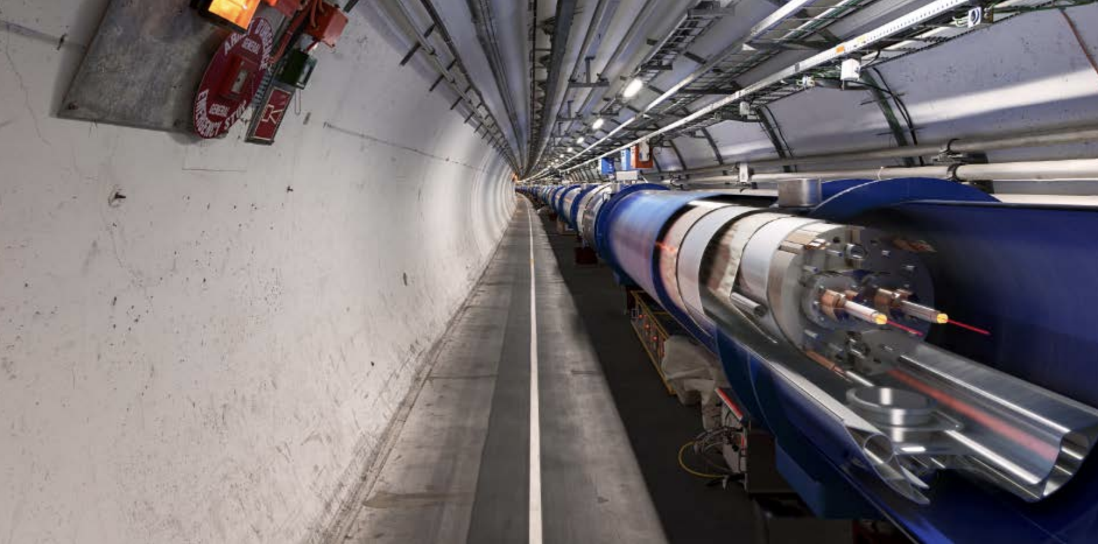
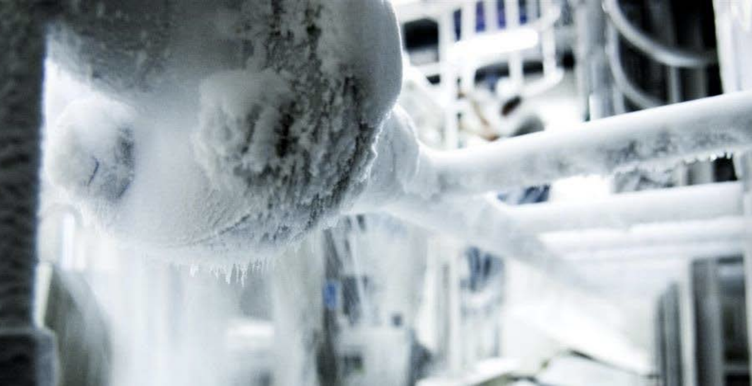
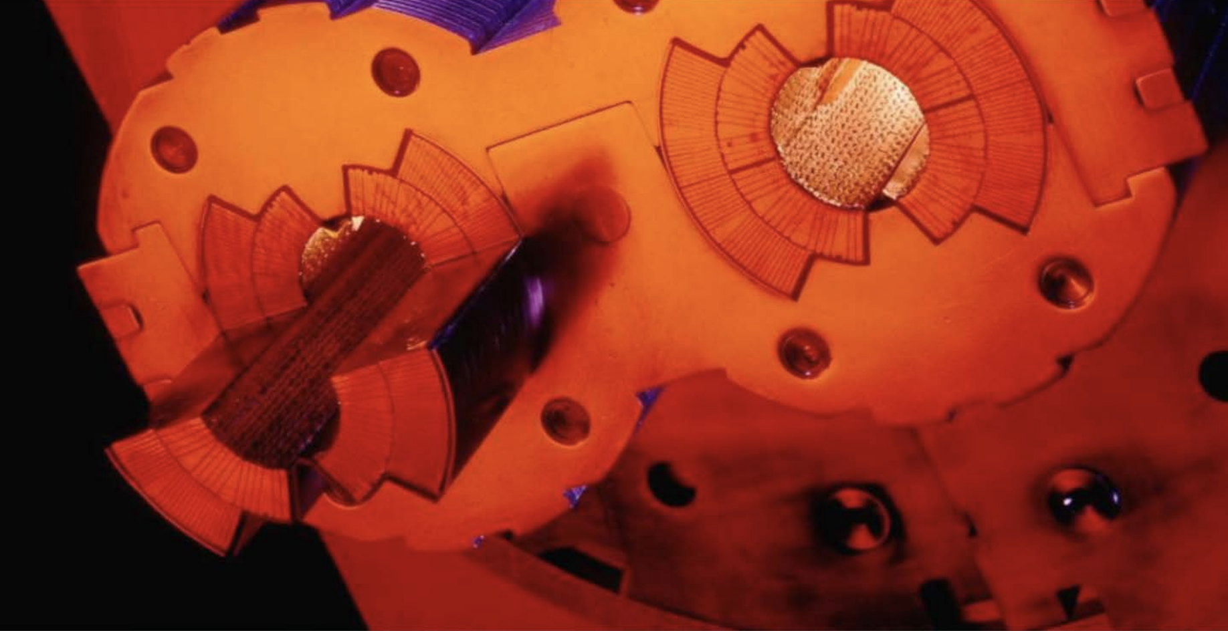
Why? …Big Data
LHC is entering the Big Data era
Accelerators infrastructure (control systems, monitoring )
9600 magnets for Beam Control
1232 superconducting dipoles for bending
Experiments (detectors & physics data)
330 PB of collisions data stored by December 2018
The computing infrastructure:
Large sets of metrics collected from system components (CPU and batch, disk and archive storage, network topology and flows, and application throughput)
LHC data represents a challenge since it is multi-structured, hybrid
Metadata
Databases Aggregation
Evolving Data model

Slide 7
From ridiculously difficult…
CMS simulation
...to almost impossible

Slide 8
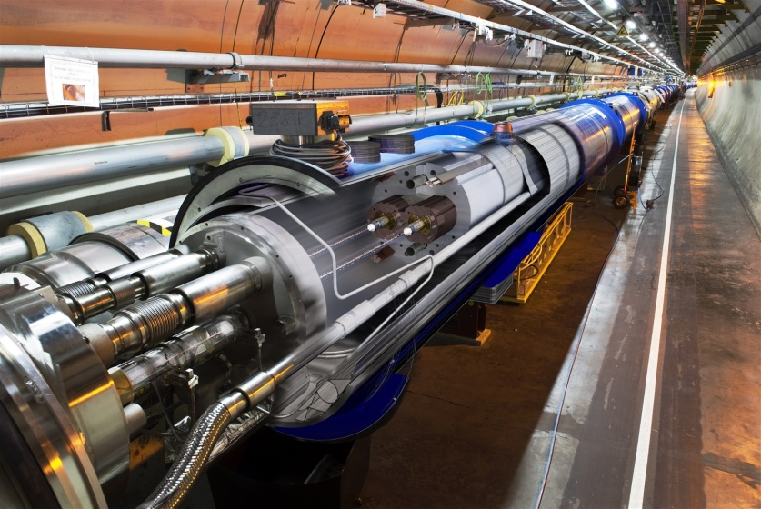
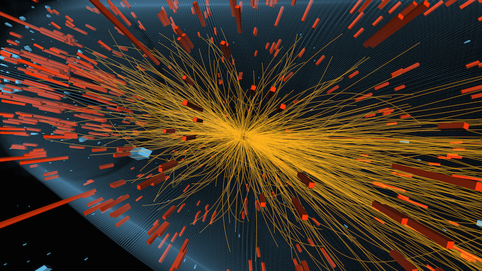
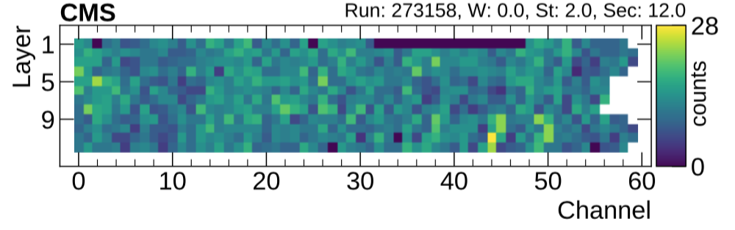
HPC and AI convergence in HEP
Deep Learning applications quickly multiply in High Energy Physics (HEP)
Extensive NN training will be a new workflow for large HEP experiments
Maximise performances
Fast turn-around for new trainings
Need dedicated hardware to be effective
HPC creates new AI models
Complicated network optimizations can have high computational cost
Train production-ready algorithms on HPC
Detector occupation map

Slide 9
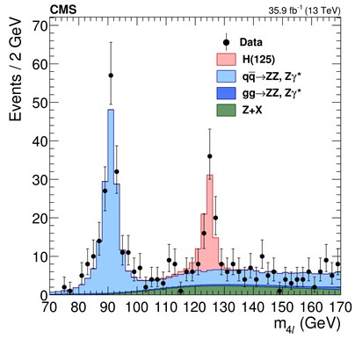

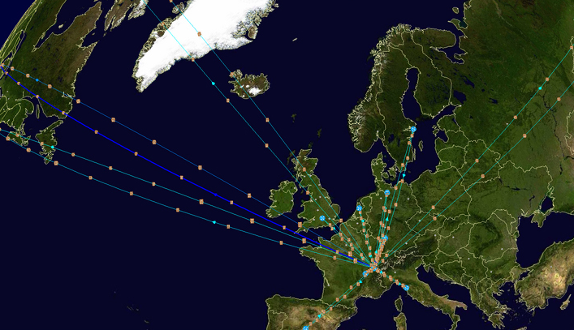
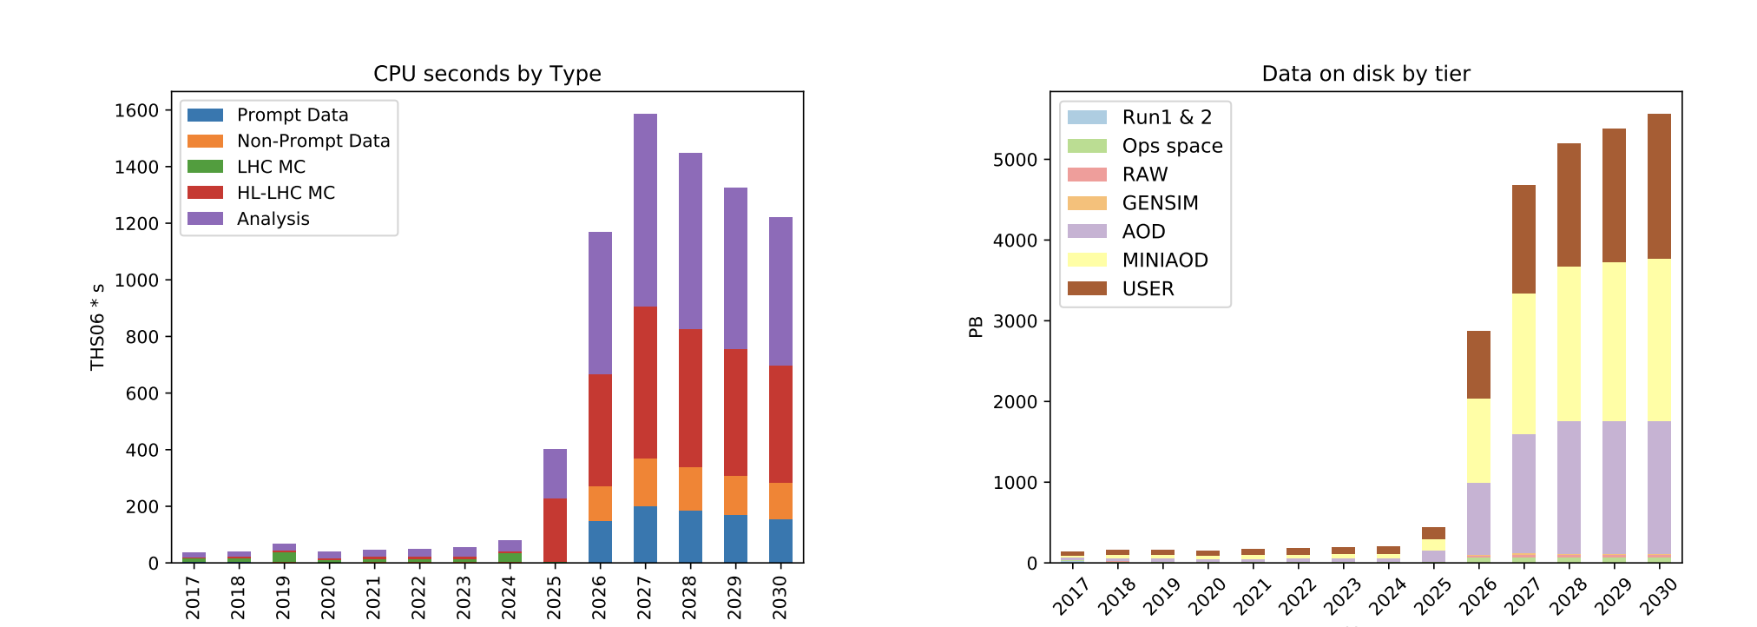
Monte Carlo Simulation
Essential for data analysis & detector design
Higgs boson
Understand how detector design affects measurements and physics
Correct for inefficiencies, inaccuracies, unknowns
Compare theory models to data
Complex physics and geometry modeling
>50% of Worldwide LHC Computing Grid (WLCG) power today
Increase by 100x by 2025!
CMS experiment
Flat Budget

Slide 10
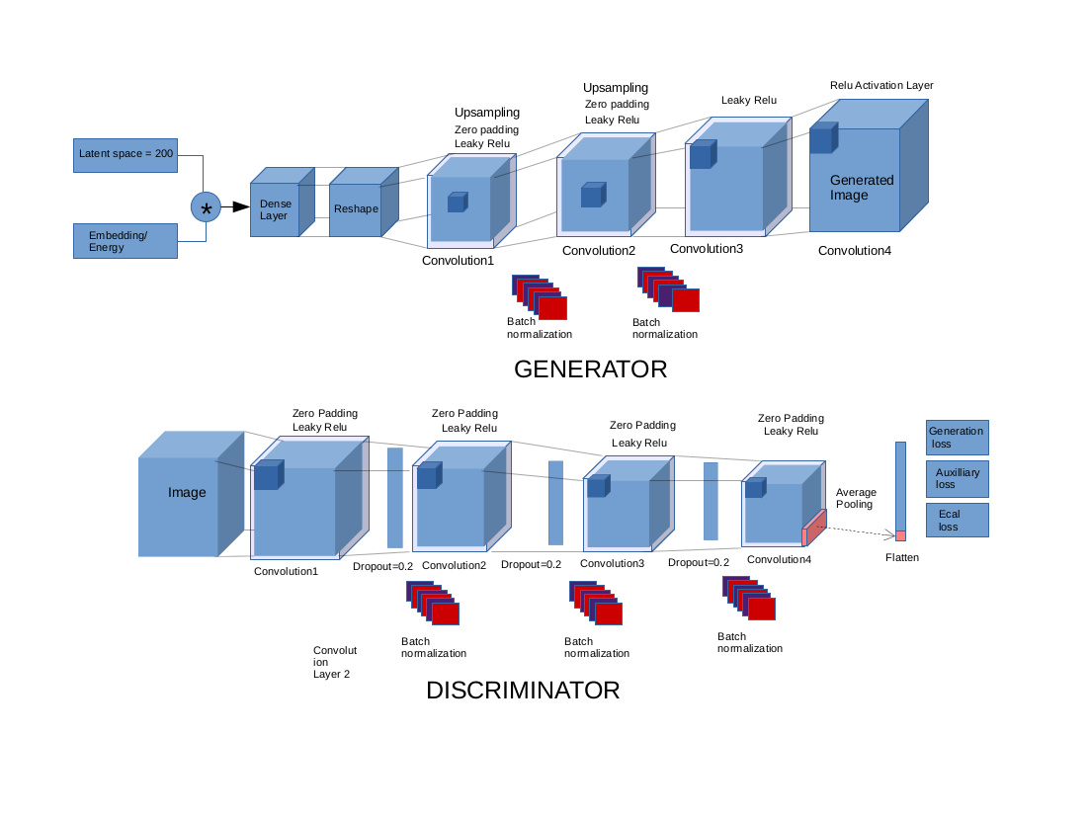
3D convolutional GAN
Generator
Discriminator
~1M parameters
Total model Size: 3.8MB

Slide 11
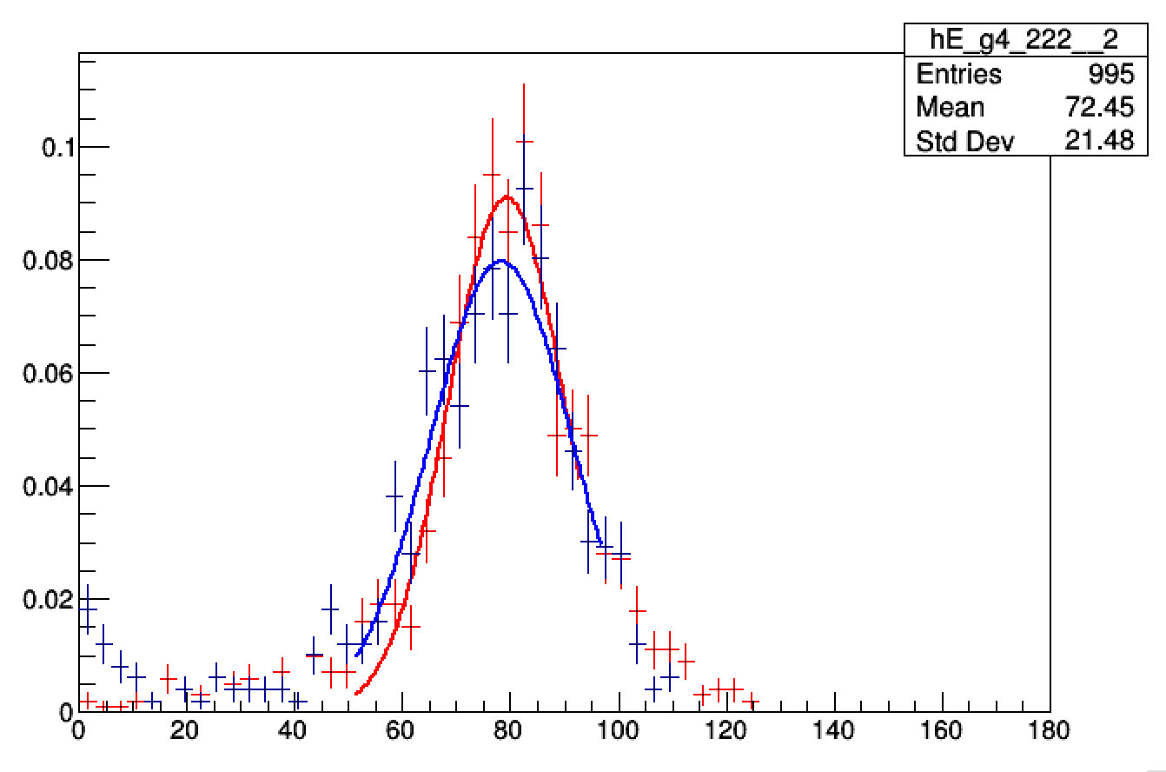
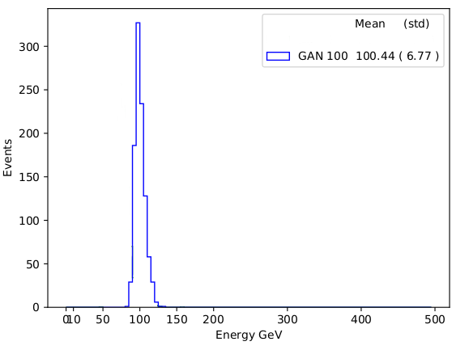
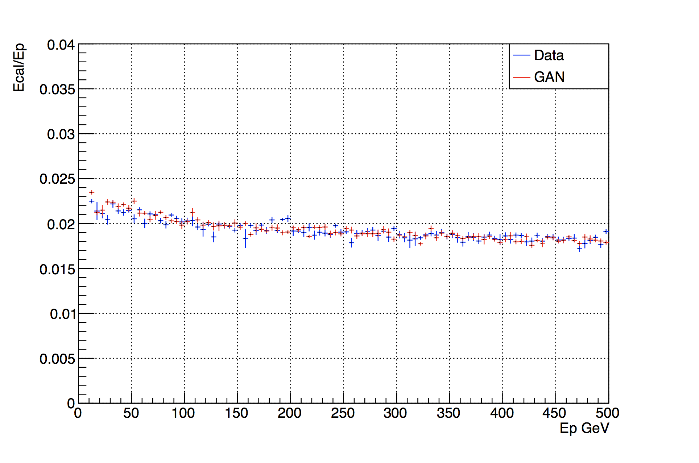
Physics results validation
Comparison to Monte Carlo data
Geant4
GAN generated
Single cell response
Primary particle energy
(100 GeV)
3D
Average shower section
GAN generated electron shower
Time to create an electron shower
Method | Machine | Time/Shower (msec)
MC Simulation (geant4) | Intel Xeon Platinum 8180 | 17000
3D GAN (batch size 128) | Intel Xeon Platinum 8180 | 7
Y moment (width)

Slide 12
Multi-Node Scaling Performance
Training Time/Epoch
94% scaling efficiency up to 128 nodes

Slide 13
Integration of AI and HPC: High Performance AI (HPAI) 18.06.2019 | Dr. David Brayford

Slide 14
Container
High Performance AI (HPAI) in a
Transition AI algorithms from the laptop to supercomputer
with minimal effort.
“It just works”

Slide 15
HPAI =
+
M&S
Analytics
Equation based on model
Computing driven
Numerically intensive
Creates simulations
Monte Carlo
Larger problems
Iterative methods
PDE
Finds patterns
Correlations in data
Logic driven
Creates inferences
Knowledge discovery
Graphs
Data-driven science
Predictions
CNN
RNN
Linear algebra
Matrix operations
Iterative methods
Compute intensive
Data transfer
Predictive
Probabilities
Stencil codes
Calculus
Pattern recognition
Graphs

Slide 16
Requirements for AI on HPC
HPAI @ LRZ
Compute intensive hardware
Optimized AI frameworks (TensorFlow, Caffe)
Optimized software (numerical libraries, Python)
HPC specific software (distributed computing, workload manager)
Method of deploying the AI software in a simple, straightforward and flexible way
Need to get to: “It just works”

Slide 17
Key Challenges
HPAI @ LRZ
Package Management
Frameworks have conflicting dependencies
→The frameworks & their dependencies need to be combined in a single module
Rapid update cycles
→Provide a mechanism for users to build there own frameworks
Dynamic Programming Environment
Python dependencies
→Each unique framework needs its own Python instance
Connecting to external servers
→Build frameworks on systems with internet access

Slide 18
Charliecloud containers in HPC
HPAI @ LRZ
Easy to install
Charliecloud was developed to be run on highly secure HPC systems
at US government labs
Charliecloud runs entirely under the User ID
Ability to run legacy design flows in containers
Low overhead and ~ 800 lines of code
LRZ deploys Charliecloud via Spack
Charliecloud is available in the module system at LRZ

Slide 19
Achieving High Performance AI on Secure HPC Systems
Deployment @ LRZ
Mechanism for deploying AI at LRZ:
Download the Intel optimized TensorFlow Docker Image (intelaipg Dockerhub)
Modify the Linux Docker image for HPC
Modify Python to enable distributed TensorFlow execution
Copy the training data and execution scripts to the modified Docker image
Convert to a Charliecloud UDSS and copy the file to the HPC system
Load the Charlicloud module
Execute on SuperMUC-NG via Slurm

Slide 20
Example Slurm script
Deployment @ LRZ
#!/bin/bash
#SBATCH --job-name="charliecloud_mpi_CERN_test_32"
#SBATCH --output="output_charliecloud_CERN_test_32.txt"
#SBATCH --error="error_charliecloud_CERN_test_32.txt"
#SBATCH --time=04:30:00
module load slurm_setup
module load mpi.intel/2019
module load devEnv/Intel/2019
module load charliecloud
mpirun -np 32 -ppn 4 ch-run -w /dss/dsshome1/08/di72giz/Docker/a408704d3f3d -- python /CERN/3Dgan-svalleco-sc18/keras/EcalEnergyTrain_hvd.py --model=EcalEnergyGan --datapath=/CERN/Data/*.h5 --channel_format='channels_first' --batchsize 16 --learningRate 0.001 --optimizer=Adam --latentsize 200 --intraop 11 --interop 1 --warmupepochs 0 --nbepochs 2

Slide 21
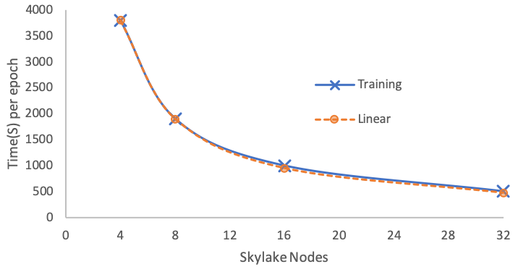
Distributed TensorFlow Results
Deployment @ LRZ
Example execution line in the Slurm script:
mpirun –np 32 –ppn 4 ch-run –w </path/to/my_image> --python <path/train.py>

Slide 22
Future
Collaboration
Together
Demonstrate vertically integrated solutions on showcase applications highlighting HPAI
BoF, presentations, workshops and tutorials
Create a community-focused HPC/AI benchmark suite
Container recipes, best practices
Release SC’19 Denver
HPC suitable Intel optimized TensorFlow Docker image
Verified recipes to enable the deployment of AI on HPC systems

